Slide 1
Hotel Summer Booking Report
Deep Insight on July and August
By Matthew Raphael NNAMANI

Slide 2
Objectives
Get insights from the year 2016 under resort hotel during the summer period (July and August)
Deduce the factors contributing to high cancellation rate
Provide recommendation/possible solutions

Slide 3
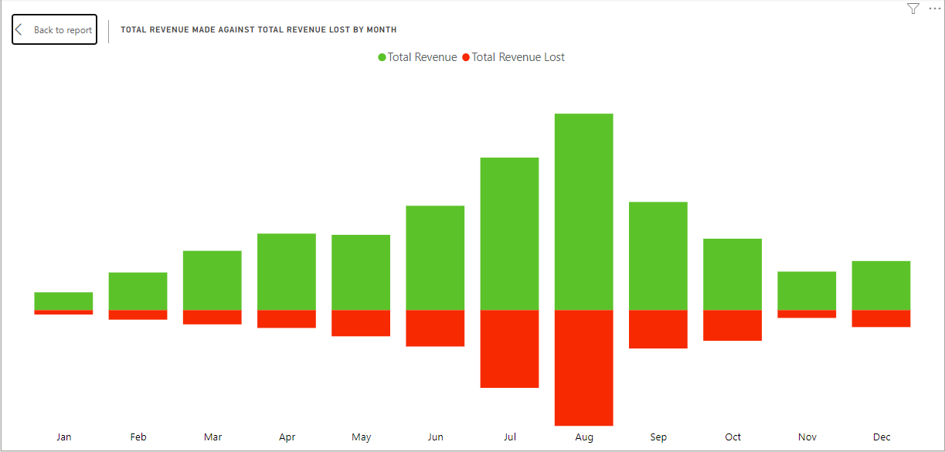
Total Revenue Made Vs Total revenue Lost By Months
In 2016, July and August generated the highest revenue and also lost the most due to cancellations
January and November generated the least revenue

Slide 4
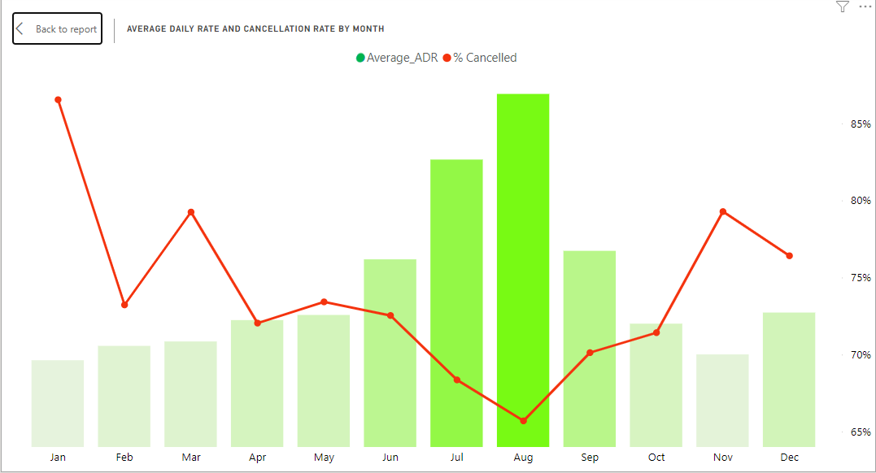
Average Daily Rate and Cancellation Rate by Months
July and August had the highest average daily rate in 2016, however, had the lowest percentage cancellation
January, March and November had the highest percentage of cancellation

Slide 5
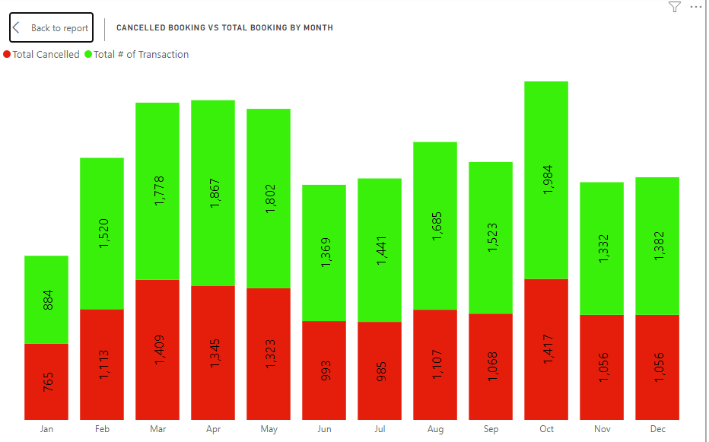
Cancelled Booking VS Total Booking by Month
July and August are among the months with lower cancelled booking.
The total number of cancelled booking in July and August against their total booking is also smaller compare to other months

Slide 6
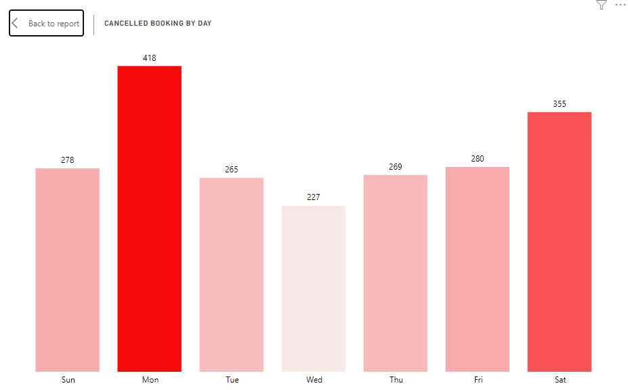
Total Number of Cancelled Bookings by Day
Monday and Saturday had the highest number of cancelled booking during the month of July and August 2016, with Wednesday having the lowest.

Slide 7
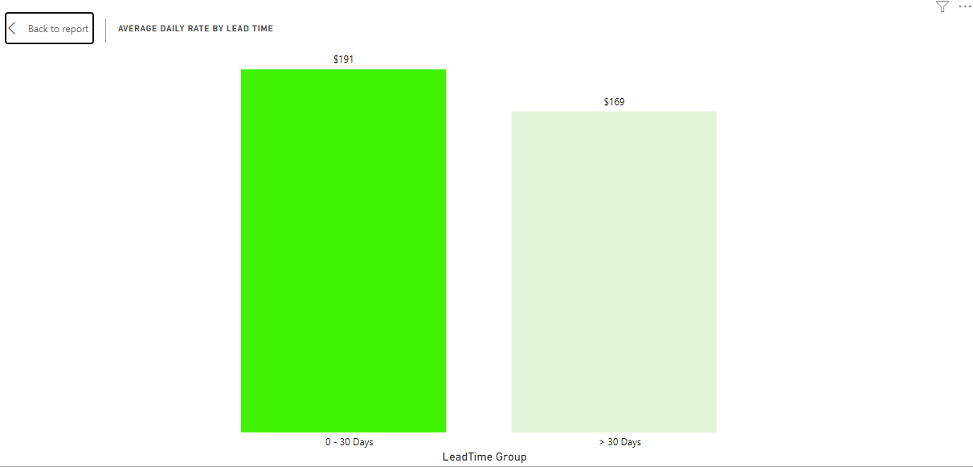
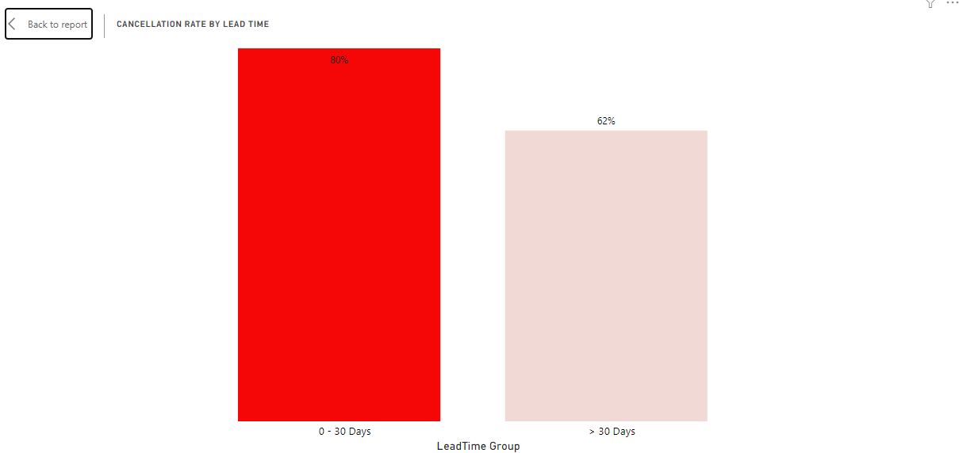
Average Daily Rate by Lead Time
Cancellation Rate by Lead Time
Lead time within 0 to 30 days had the highest rate of cancellation, this could be to the high average daily rate during the months of July and August in 2016.

Slide 8
Recommendations
The average daily rate should be reviewed and if possible reduced especially for summer (July and August) bookings with lead time between 0 to 30 days, this will decrease the likelihood of cancellation.
Although July and August brought in more revenue than other months and had lower number of cancelled booking compared to most months, the revenue lost was the highest, overbooking during the summer will ensure lost of revenue does not affect the generation of revenue during this period
Other marketing strategies like target advertising, organization of seasonal events and activities, creation of promotional packages can also be implemented

